Slide 1

Lab 2.3a Example Distribution Model
Notes:
1

Slide 2
Objectives
This Lab is a basic example to illustrate how distribution models can be used to represent and update probability distributions of rewards in a bandit problem.
Lab 2.3a Example Distribution model
2
Notes:
2

Slide 3
Lab Guide Coding
Using given code
We have a two-armed bandit environment represented by the Bandit class, where each arm has a true mean reward.
The DistributionModel class represents the distribution model, which maintains the mean and variance of rewards for each arm.
During each iteration, the agent selects an arm to pull, observes the reward, and updates the distribution model accordingly.
After a certain number of pulls, we print the updated mean and variance of rewards for each arm.
Lab 2.3a Example Distribution model
3
Notes:
3

Slide 4
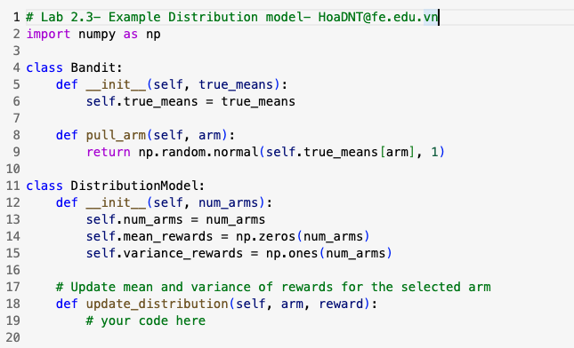
Lab Guide Coding
Lab 2.3a Example Distribution model
4
Notes:
4

Slide 5
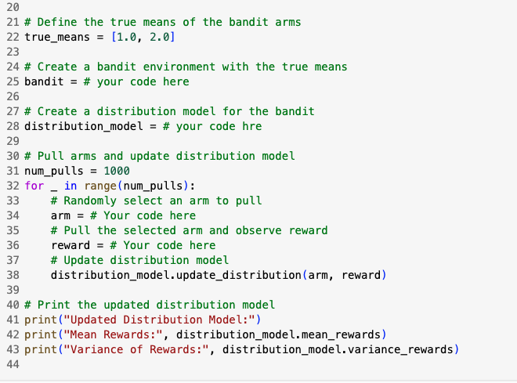
Lab Guide Coding
Lab 2.3a Example Distribution model
5
Notes:
5

Slide 6
Q & A
Lab 2.3a Example Distribution model
6

